Slide 1
Can you guess my mystery job?

Slide 2
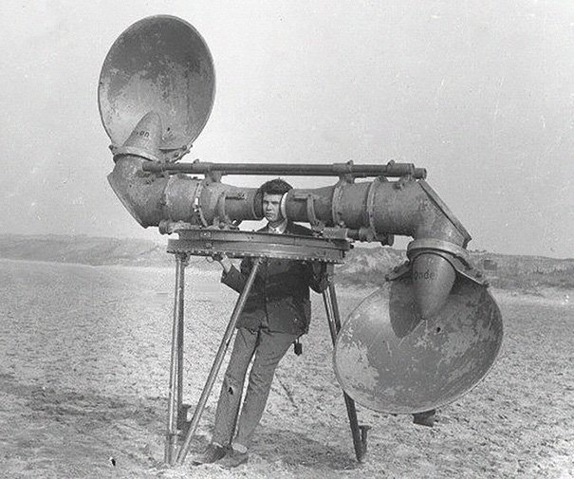
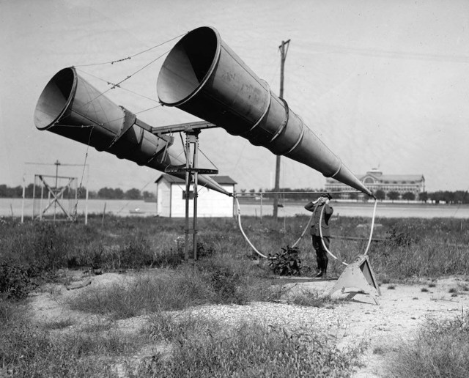
Who would have known that being a quiet person would be so important?
His shift started at 9 a.m., and when he walked out into the early morning air, he looked around at an empty blue sky. The birds had even gone quiet in the hot morning sun. This would be helpful.
He hiked a half mile away from the barracks on a well-worn path into the clearing, far away from the noises and bustle of camp life.
He remembered his grandfather, barely able to hear without it, holding a metal funnel to his ear to aid his hearing.
“Speak into the funnel, Lawrence, so I can hear you,” his Grandfather would tell him.
Now, in this time of war, the funnels—comically large—were attached to his own ears.
What is the sound of an enemy’s motor in the air? Where does the sound move? Does it approach?
He had been trained for this. Now, he must relax, breathe evenly, quiet his own heart so he could hear in case he needed to sound the alarm.
Who would have known that being a quiet person would be so important?

Slide 4
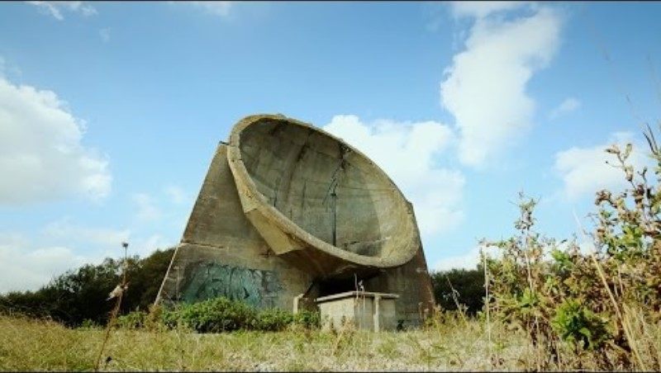
If video fails to download, watch it here:
https://www.youtube.com/watch?v=yB5C1OMloeI&t=48s

